Slide 1



AutoBuddy: A Car Shopping Search Chatbot
AI-powered chatbot for personalized car shopping.
Farid Ghorbani

Slide 2

Key Features
1
Personalized Car Recommendations
based on user preferences (e.g., budget, car type, brand).
2
Advanced (RAG)
pipeline for contextually relevant responses.
3
Fine-Tuned LLM (GPT-4o-mini)
for precise, domain-specific car shopping insights.
4
Performance Evaluation
using context relevance and human-assessed answer relevance.

Slide 3
Technologies Used
User Interface
Backend
Data Sources
Chatbot interface built with Streamlit for user interactions.
LangChain and RAG for query processing and data retrieval.
Car listings and dealer info stored in Pinecone.
LLM
OpenAI API for natural language processing and response generation.

Slide 4

Data Collection Phase
Sources
Various online new car company and dealer inventories websites.
Content
Car specifications, prices, features, and dealer information.
Methods
Web scraping and API integration with databases.

Slide 5
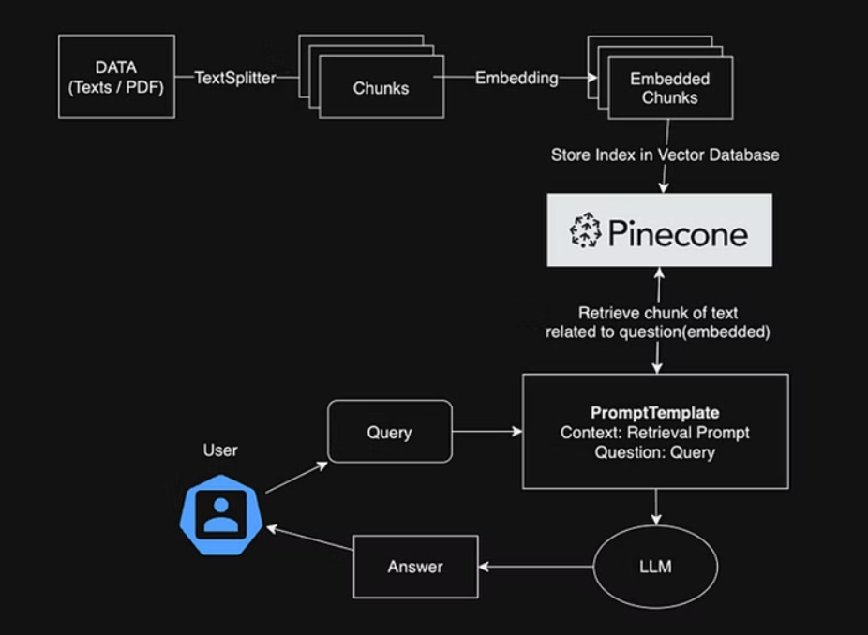
RAG Pipeline Implementation

Slide 6
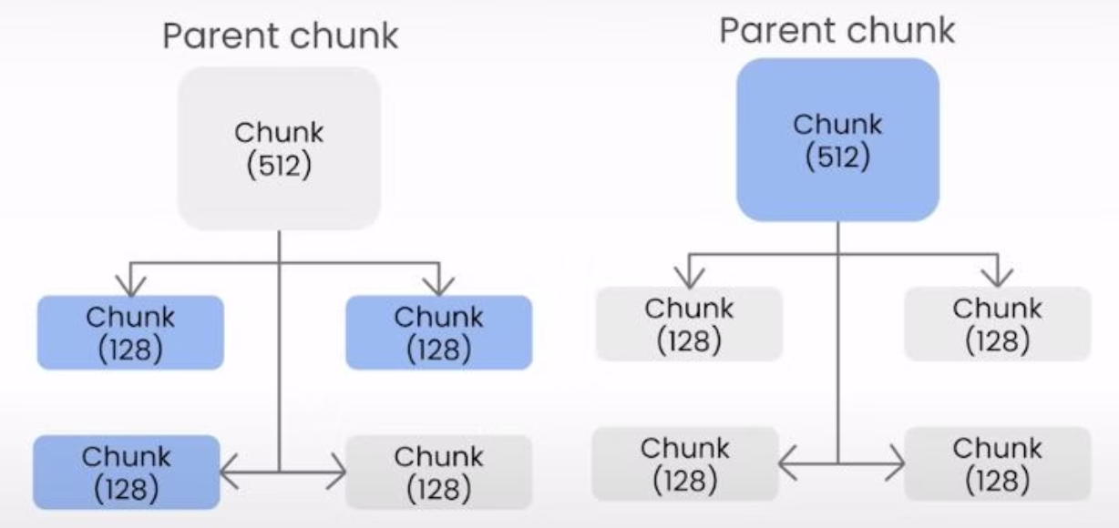
Advanced RAG Technique
Auto-Merging Retrieval

Slide 7
Fine-Tuning LLMs
1
Prepare Training Data
Create datasets representative of the desired tasks.
2
Uploading a Training File for Fine-Tuning
Uploading our training data is a crucial step.
3
Train a New Fine-Tuned Model
Create a Fine-Tuning Job.
4
Using a Fine-Tuned Model
After completing the fine-tuning process, the newly fine-tuned model can be integrated into the AutoBuddy chatbot.

Slide 8
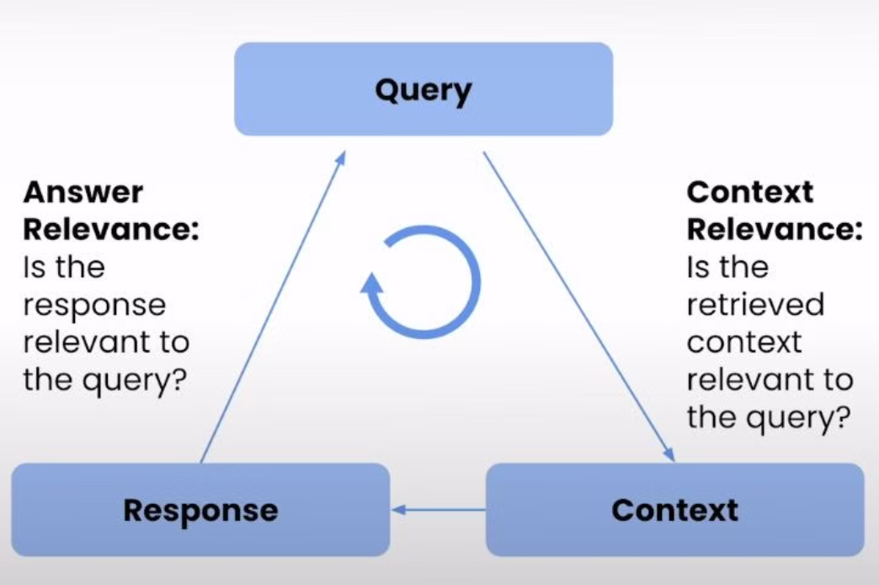
Evaluate Performance

Slide 9
Evaluating Context Relevance
1
Query Generation
Generate a broad set of prompts to cover a wide range of queries.
2
Context Retrieval
For each query, we retrieve the context using the RAG pipeline.
3
Text Vectorization
We use Term Frequency-Inverse Document Frequency (TF-IDF) to convert the texts (both questions and retrieved contexts) into numerical vectors, which allows for easier comparison of the importance of words in each document.
4
Cosine Similarity Calculation
Cosine similarity is employed to measure the cosine of the angle between two vectors, representing the degree of similarity between them.

Slide 10
Evaluating Answer Relevance
1
Context Retrieval and Answer Generation
For each query, the RAG pipeline generates a context retrieval and a chatbot answer.
2
Human Assessment
The answers are evaluated through human assessment.
3
User Feedback
User feedback is also collected and analyzed as part of the Answer Relevance evaluation.

Slide 11
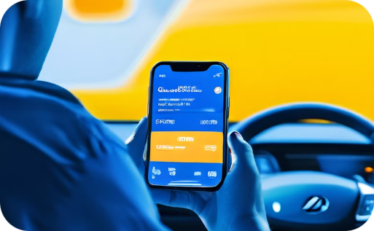


Conclusion
Result
Further discussion
Thank you
AutoBuddy represents a significant step forward in the use of AI for simplifying complex decision-making processes in the car shopping industry.
For more detail, you can visit my GitHub repository linked in the description.
Thanks for watching! If you found this video helpful, please give it a thumbs up and subscribe to my channel for more tutorials like this. See you in the next video!

